Slide 1
Medical Science's true beauty emerges when approached from the right Angle…

Slide 2
Scientific Angle is a medical writing company that approaches Science

Slide 3
Thoroughly

Slide 4
Methodically

Slide 5
Intently

Slide 6
To create what we call
ELOQUENT TEXT

Slide 7
ELOQUENT TEXT
Eloquent text is the content in which the doctors find merit, and the sponsor finds value.

Slide 8

Scientific Angle
Welcome to Scientific Angle, where the language of medicine converges with the art of communication. We meticulously gather the strands of biomedical information and weave them into a tapestry of medically relevant and captivating communication. With utmost care, we craft high-quality content tailored to your unique needs, ensuring that it aligns with established guidelines. Let us be your partners to fulfill your medical communication needs.
Our work
We support you in:
Medico-marketing communication
Continued medical education writing and elegant PPTs
Patient education content
Key opinion leader management
Manuscript writing for publications

Slide 9
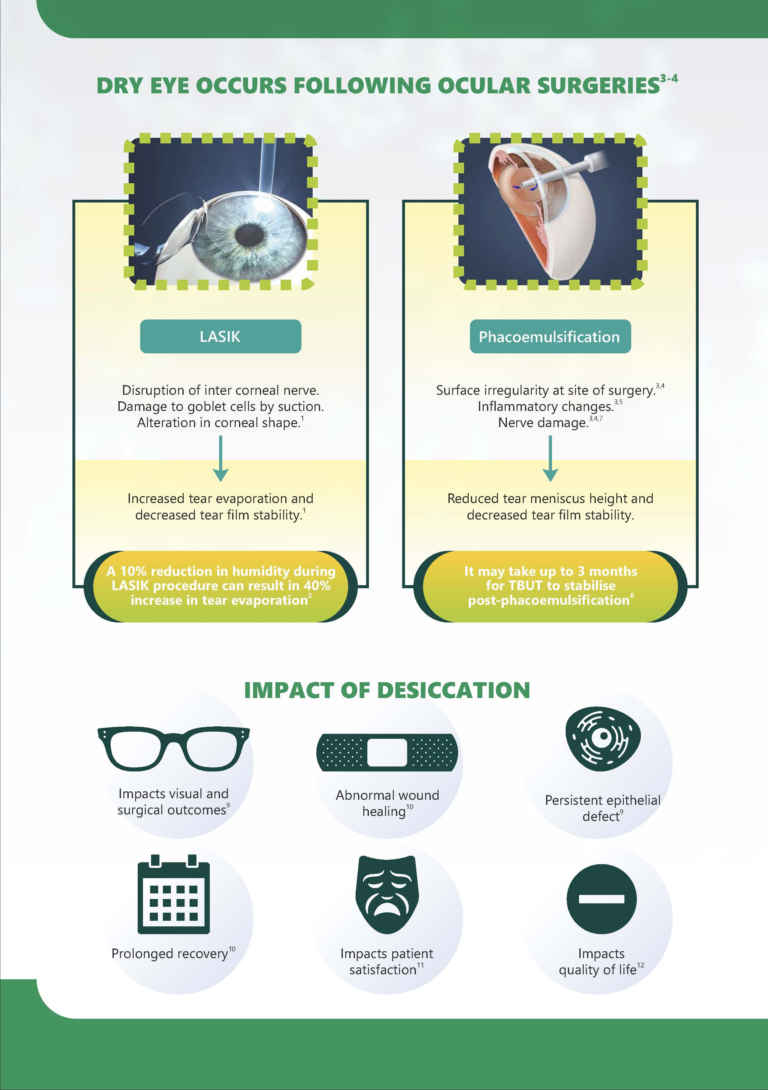
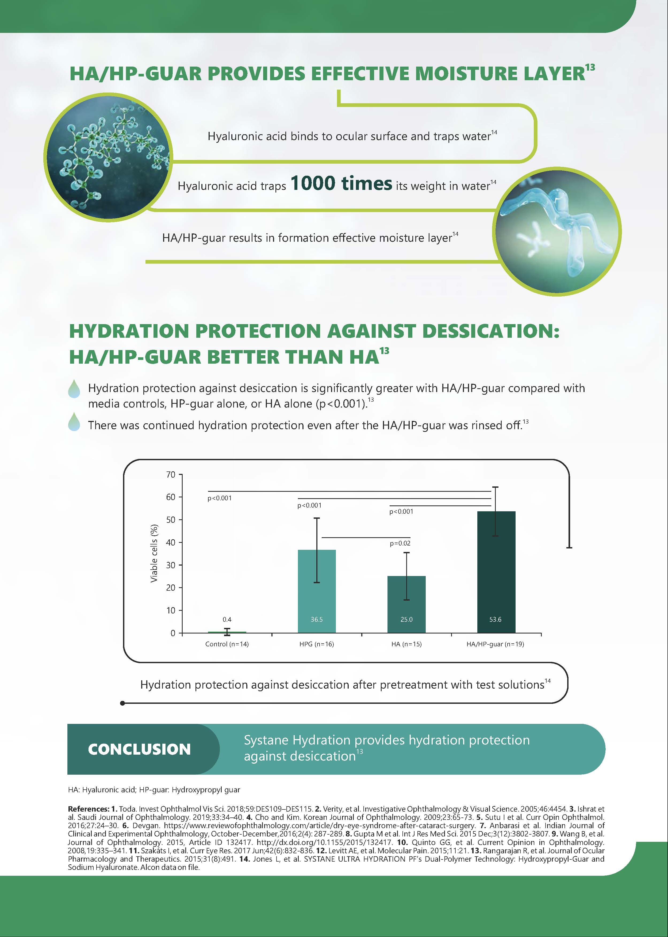
Medico-marketing communication
Strong presentation of rationale for writing content and identification of gaps
We give a very strong rationale for writing a product. The rationale is not just based on the clinical efficacy data points but also based on strong scientific fundamentals for the use of the drug. The content is written by selecting the right words, using the right infographics, and using the right data.
See more
Presenting the patients’ perspective/benefit to patient
Capturing data effectively to get quick attention of the reader

Slide 10
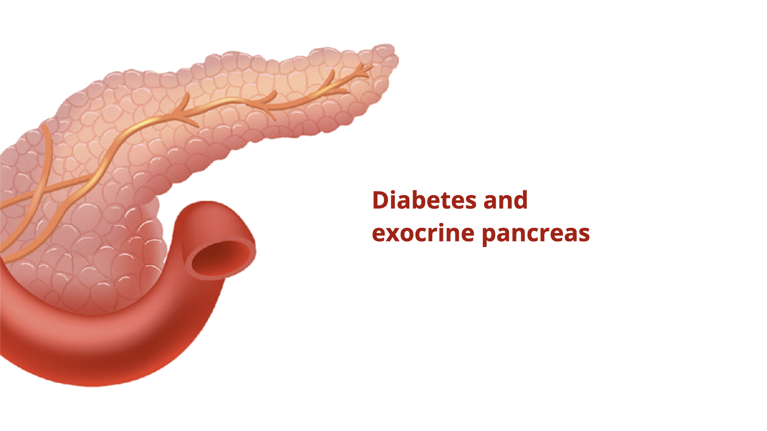
Continued Medical Education & Power point presentations
PowerPoint presentations are at the heart of communication. They are needed for education, CME marketing and sales. We create high-quality PPT content following thoroughly searching the medical literature. The content tone is tailor-made to the specified target audience. We prefer data to speak as much as possible over text. The captive flow and creative infographics are at the heart of our presentations.
See more

Slide 11
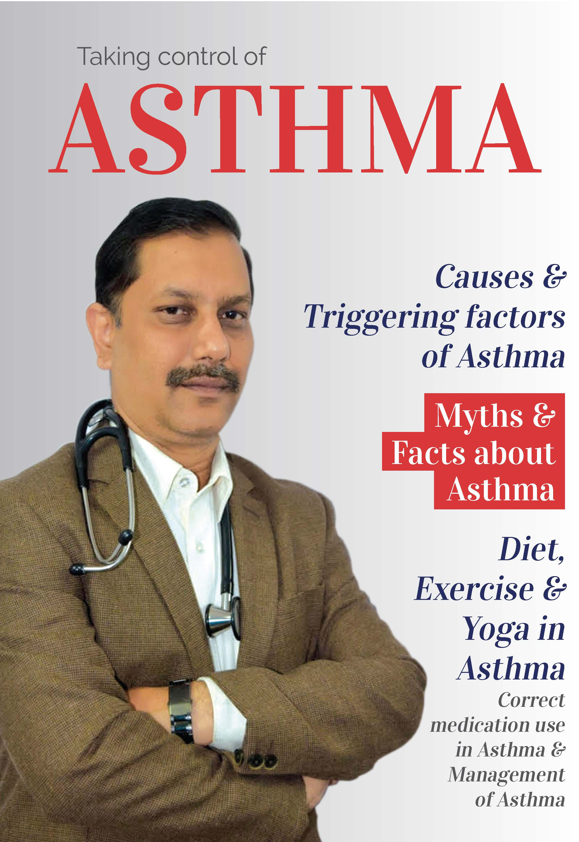
Patient education content
We understand that Patients are very important partners in healthcare. Our content is written in the simplest possible language, with images and infographics. Highschool students can even understand our content. Our patient education content is demanded by doctors and printed again and again.
See more

Slide 12
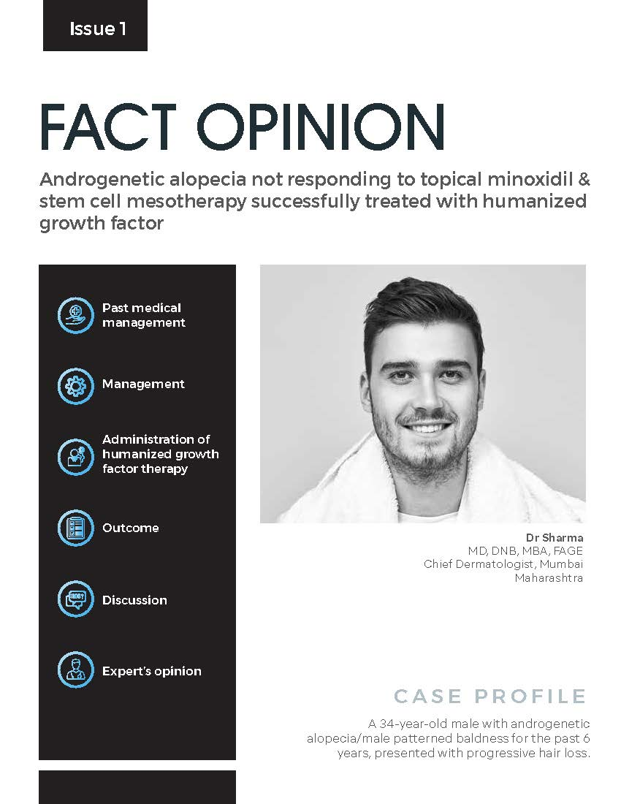
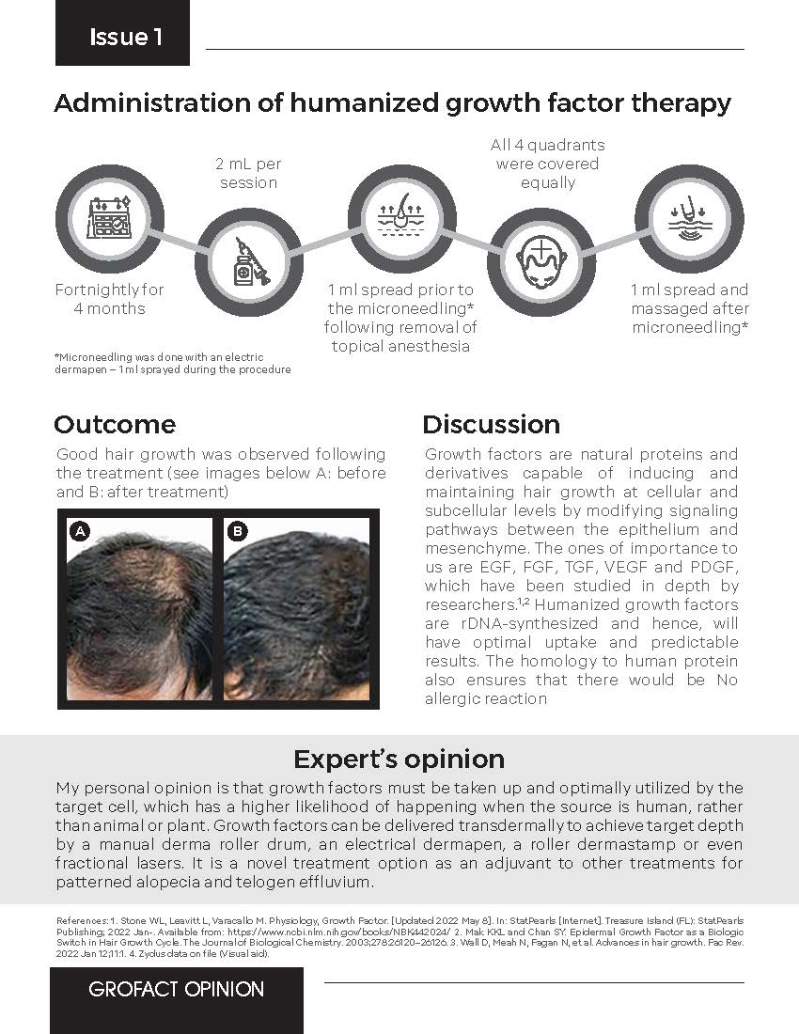
KOL Management
Treatment presented effectively as infographic
Case reports, clinical opinions, CMEs and whatnot, KOL opinion is very important and useful in medical communication. We interact with KOLs of almost all medical specialties in India. We try our best to get what KOLs requires in the minimum possible time.
See more
The case presented with clinical image
Complemented by expert opinion

Slide 13
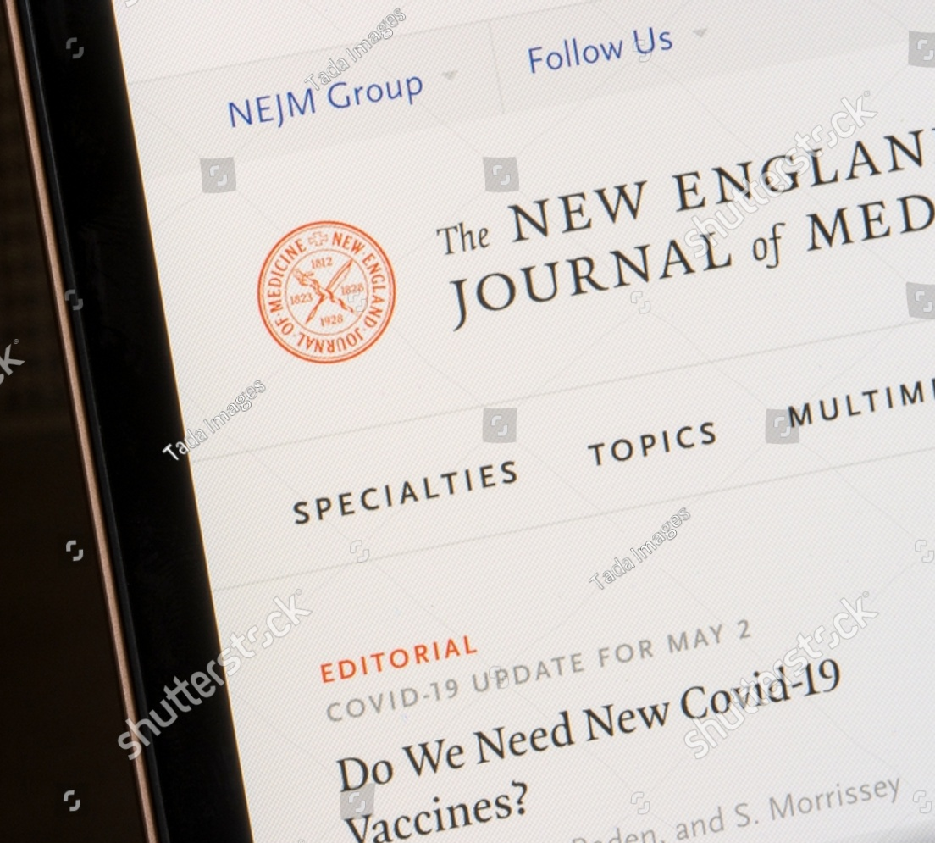
Manuscript writing
We provide manuscript writing, editorial support, including data fact check, statistical analysis, case study/case study series, book chapters, post-Marketing surveys, and medical data management.

Slide 14
Our clients
Alcon
Zydus
Dr. Reddy’s Laboratories
Allergan
Glenmark
Zuventus
McLeods
Sun Pharma
Natural Remedies
Abbott
Sanofi
Cipla
Alkem
Unichem
Fourrts
Hetero
Emcure
USV
Unichem
Lupin
Wockhardt

Slide 15
Contact us
Contact information

